Slide 1
Turing Machine
Turing Machines
Recursive and Recursively Enumerable Languages

Slide 2
Turing-Machine Theory
The purpose of the theory of Turing machines is to prove that certain specific languages have no algorithm.
Start with a language about Turing machines themselves.
Reductions are used to prove more common questions undecidable.

Slide 3
Picture of a Turing Machine
Action: based on
the state and the
tape symbol under
the head: change
state, rewrite the
symbol and move the
head one square.
State
. . .
A
B
C
A
D
. . .
Infinite tape with
squares containing
tape symbols chosen
from a finite alphabet

Slide 4
Why Turing Machines?
Why not deal with C programs or something like that?
Answer: You can, but it is easier to prove things about TM’s, because they are so simple.
And yet they are as powerful as any computer.
More so, in fact, since they have infinite memory.

Slide 5
Turing-Machine Formalism
A TM is described by:
A finite set of states (Q, typically).
An input alphabet (Σ, typically).
A tape alphabet (Γ, typically; contains Σ).
A transition function (δ, typically).
A start state (q₀, in Q, typically).
A blank symbol (B, in Γ- Σ, typically).
All tape except for the input is blank initially.
A set of final states (F ⊆ Q, typically).

Slide 6
Conventions
a, b, … are input symbols.
…, X, Y, Z are tape symbols.
…, w, x, y, z are strings of input symbols.
α, β,… are strings of tape symbols.

Slide 7
The Transition Function
Takes two arguments:
A state, in Q.
A tape symbol in Γ.
δ(q, Z) is either undefined or a triple of the form (p, Y, D).
p is a state.
Y is the new tape symbol.
D is a direction, L or R.

Slide 8
Example: Turing Machine
This TM scans its input right, looking for a 1.
If it finds one, it changes it to a 0, goes to final state f, and halts.
If it reaches a blank, it changes it to a 1 and moves left.

Slide 9
Example: Turing Machine – (2)
States = {q (start), f (final)}.
Input symbols = {0, 1}.
Tape symbols = {0, 1, B}.
δ(q, 0) = (q, 0, R).
δ(q, 1) = (f, 0, R).
δ(q, B) = (q, 1, L).

Slide 10
Simulation of TM
δ(q, 0) = (q, 0, R)
δ(q, 1) = (f, 0, R)
δ(q, B) = (q, 1, L)
q
. . . B B 0 0 B B . . .

Slide 11
Simulation of TM
δ(q, 0) = (q, 0, R)
δ(q, 1) = (f, 0, R)
δ(q, B) = (q, 1, L)
q
. . . B B 0 0 B B . . .

Slide 12
Simulation of TM
δ(q, 0) = (q, 0, R)
δ(q, 1) = (f, 0, R)
δ(q, B) = (q, 1, L)
q
. . . B B 0 0 B B . . .

Slide 13
Simulation of TM
δ(q, 0) = (q, 0, R)
δ(q, 1) = (f, 0, R)
δ(q, B) = (q, 1, L)
q
. . . B B 0 0 1 B . . .

Slide 14
Simulation of TM
δ(q, 0) = (q, 0, R)
δ(q, 1) = (f, 0, R)
δ(q, B) = (q, 1, L)
q
. . . B B 0 0 1 B . . .

Slide 15
Simulation of TM
δ(q, 0) = (q, 0, R)
δ(q, 1) = (f, 0, R)
δ(q, B) = (q, 1, L)
f
No move is possible.
The TM halts and
accepts.
. . . B B 0 0 0 B . . .

Slide 16
Instantaneous Descriptions of a Turing Machine
Initially, a TM has a tape consisting of a string of input symbols surrounded by an infinity of blanks in both directions.
The TM is in the start state, and the head is at the leftmost input symbol.

Slide 17
TM ID’s – (2)
An ID is a string αqβ, where αβ includes the tape between the leftmost and rightmost nonblanks.
The state q is immediately to the left of the tape symbol scanned.
If q is at the right end, it is scanning B.
If q is scanning a B at the left end, then consecutive B’s at and to the right of q are part of α.

Slide 18
TM ID’s – (3)
As for PDA’s we may use symbols ⊦ and ⊦* to represent “becomes in one move” and “becomes in zero or more moves,” respectively, on ID’s.
Example: The moves of the previous TM are q00⊦0q0⊦00q⊦0q01⊦00q1⊦000f

Slide 19
Formal Definition of Moves
If δ(q, Z) = (p, Y, R), then
αqZβ⊦αYpβ
If Z is the blank B, then also αq⊦αYp
If δ(q, Z) = (p, Y, L), then
For any X, αXqZβ⊦αpXYβ
In addition, qZβ⊦pBYβ

Slide 20
Languages of a TM
A TM defines a language by final state, as usual.
L(M) = {w | q₀w⊦*I, where I is an ID with a final state}.
Or, a TM can accept a language by halting.
H(M) = {w | q₀w⊦*I, and there is no move possible from ID I}.

Slide 21
Equivalence of Accepting and Halting
If L = L(M), then there is a TM M’ such that L = H(M’).
If L = H(M), then there is a TM M” such that L = L(M”).

Slide 22
Proof of 1: Final State -> Halting
Modify M to become M’ as follows:
For each final state of M, remove any moves, so M’ halts in that state.
Avoid having M’ accidentally halt.
Introduce a new state s, which runs to the right forever; that is δ(s, X) = (s, X, R) for all symbols X.
If q is not a final state, and δ(q, X) is undefined, let δ(q, X) = (s, X, R).

Slide 23
Proof of 2: Halting -> Final State
Modify M to become M” as follows:
Introduce a new state f, the only final state of M”.
f has no moves.
If δ(q, X) is undefined for any state q and symbol X, define it by δ(q, X) = (f, X, R).

Slide 24
Recursively Enumerable Languages
We now see that the classes of languages defined by TM’s using final state and halting are the same.
This class of languages is called the recursively enumerable languages.
Why? The term actually predates the Turing machine and refers to another notion of computation of functions.

Slide 25
Recursive Languages
An algorithm is a TM, accepting by final state, that is guaranteed to halt whether or not it accepts.
If L = L(M) for some TM M that is an algorithm, we say L is a recursive language.
Why? Again, don’t ask; it is a term with a history.

Slide 26
Example: Recursive Languages
Every CFL is a recursive language.
Use the CYK algorithm.
Almost anything you can think of is recursive.

Slide 27
Turing Machine Programming
Example 1.
Construct a DTM to accept the language
L = {a^{n}b^{n} | n≥0}.
a
a
a
b
b
b
B
B

Slide 28
Turing Machine Programming
B / B, R
a / a, R
a / a, L
0
a / B, R
1
B / B, L
2
b / B, L
3
B / B, R
b / b, L
b / b, R
4
a
a
a
b
b
b
B
B

Slide 29
Turing Machine Programming
Example 2.
Program a DTM to shift its input words right by one cell, placing a blank in the leftmost cell.
a
b
b
a
B
B
B
a
b
b
a
B
B

Slide 30
Turing Machine Programming
B / B, λ
a / a, R
a / B, R
A
a / b, R
b / B, R
B / a, λ
b / a, R
B
B / b, λ
f
b / b, R

Slide 31
Turing Machine Programming
Example 3.
Program a DTM to shift its input word cyclically to the right by one position.
a
b
b
a
B
B
a
a
b
b
B
B

Slide 32
Turing Machine Programming
B / B, λ
a / B, R
a / a, R
a / b, R
b / B, R
B / a, λ
b / a, R
a / a, L
a / B, L
B / b, λ
b / b, L
b / b, R
b / B, L
B / a, λ
a / a, L
B / b, λ
b / b, L

Slide 33
Turing Machine Programming
Example 4.
Let Σ = { a, b} and L = { ba^{i}b : | i≥0 }. Construct a DTM to decide L.
a / a, R
b / b, R
b / b, R
B / B, L

Slide 34
Turing Machine Programming
B / n, λ
a / a, R
a / B, L
b / b, R
b / a, R
B / B, L
a / a, R
a / b, R
B / a, R
b / a, R
b / y, λ
a / a, R
b / a, R
B / B, L
b / n, λ
a / B, L

Slide 35
More About Turing Machines
“Programming Tricks”
Restrictions
Extensions
Closure Properties

Slide 36
Programming Trick: Multiple Tracks
Think of tape symbols as vectors with k components, each chosen from a finite alphabet.
Makes the tape appear to have k tracks.
Let input symbols be blank in all but one track.

Slide 37
Picture of Multiple Tracks
Represents
input symbol 0
q
Represents
the blank
0
X
B
B
Y
B
B
Z
B
Represents one symbol [X,Y,Z]

Slide 38
track 1
track 2
track 1
track 2

Slide 39
Programming Trick: Marking
A common use for an extra track is to mark certain positions.
Almost all tape squares hold B (blank) in this track, but several hold special symbols (marks) that allow the TM to find particular places on the tape.

Slide 40
Marking
q
B
X
B
W
Y
Z
Unmarked
W and Z
Marked Y

Slide 41
Programming Trick: Caching in the State
The state can also be a vector.
First component is the “control state.”
Other components hold data from a finite alphabet.
Turing Maching with Storage

Slide 42
Example: Using These Tricks
This TM doesn’t do anything terribly useful; it copies its input w infinitely.
Control states:
q: Mark your position and remember the input symbol seen.
p: Run right, remembering the symbol and looking for a blank. Deposit symbol.
r: Run left, looking for the mark.

Slide 43
Example – (2)
States have the form [x, Y], where x is q, p, or r and Y is 0, 1, or B.
Only p uses 0 and 1.
Tape symbols have the form [U, V].
U is either X (the “mark”) or B.
V is 0, 1 (the input symbols) or B.
[B, B] is the TM blank; [B, 0] and [B, 1] are the inputs.

Slide 44
The Transition Function
Convention: a and b each stand for “either 0 or 1.”
δ([q,B], [B,a]) = ([p,a], [X,a], R).
In state q, copy the input symbol under the head (i.e., a ) into the state.
Mark the position read.
Go to state p and move right.

Slide 45
Transition Function – (2)
δ([p,a], [B,b]) = ([p,a], [B,b], R).
In state p, search right, looking for a blank symbol (not just B in the mark track).
δ([p,a], [B,B]) = ([r,B], [B,a], L).
When you find a B, replace it by the symbol (a ) carried in the “cache.”
Go to state r and move left.

Slide 46
Transition Function – (3)
δ([r,B], [B,a]) = ([r,B], [B,a], L).
In state r, move left, looking for the mark.
δ([r,B], [X,a]) = ([q,B], [B,a], R).
When the mark is found, go to state q and move right.
But remove the mark from where it was.
q will place a new mark and the cycle repeats.

Slide 47
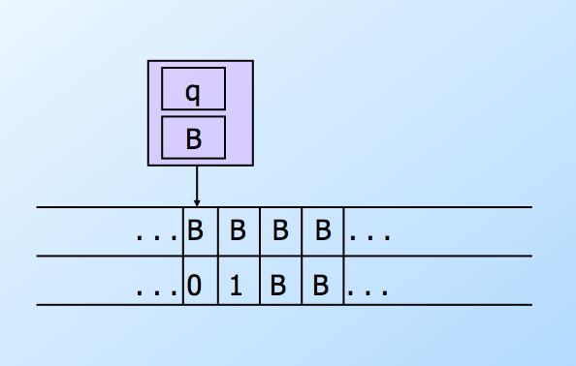
Simulation of the TM

Slide 48
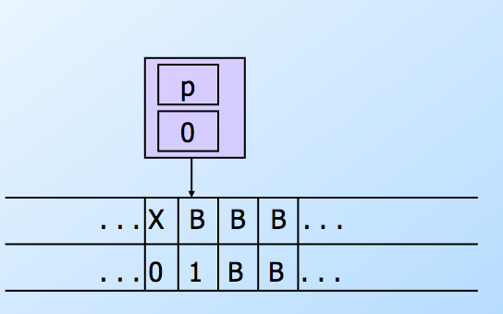
Simulation of the TM

Slide 49
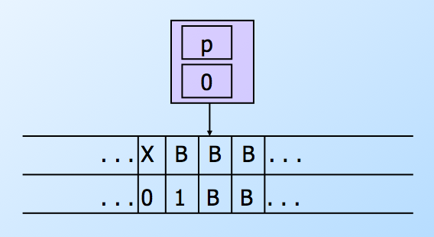
Simulation of the TM

Slide 50
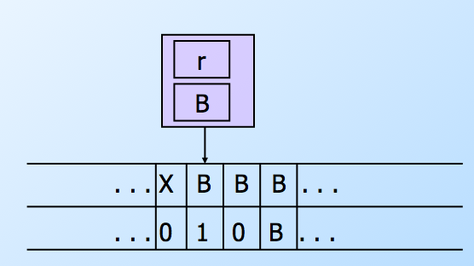
Simulation of the TM

Slide 51
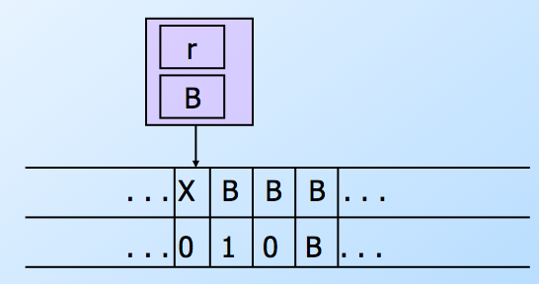
Simulation of the TM

Slide 52
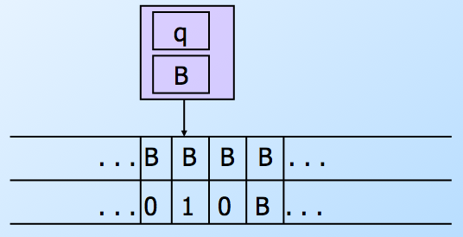
Simulation of the TM

Slide 53
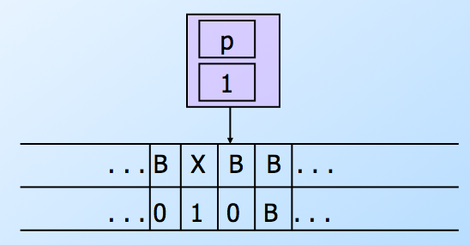
Simulation of the TM

Slide 54
Semi-infinite Tape
We can assume the TM never moves left from the initial position of the head.
Let this position be 0; positions to the right are 1, 2, … and positions to the left are –1, –2, …
New TM has two tracks.
Top holds positions 0, 1, 2, …
Bottom holds a marker, positions –1, –2, …

Slide 55
Simulating Infinite Tape by Semi-infinite Tape
State remembers whether
simulating upper or lower
track. Reverse directions
for lower track.
q
U/L
0 1 2 3 . . .
* -1 -2 -3 . . .
Put * here
at the first
move
You don’t need to do anything,
because these are initially B.

Slide 56
More Restrictions
Two stacks can simulate one tape.
One holds positions to the left of the head; the other holds positions to the right.
In fact, by a clever construction, the two stacks to be counters = only two stack symbols, one of which can only appear at the bottom.

Slide 57
Extensions
More general than the standard TM.
But still only able to define the same languages.
Multitape TM.
Nondeterministic TM.
Store for name-value pairs.

Slide 58
Multitape Turing Machines
Allow a TM to have k tapes for any fixed k.
Move of the TM depends on the state and the symbols under the head for each tape.
In one move, the TM can change state, write symbols under each head, and move each head independently.

Slide 59
Tape 1
Time 1
Tape 2
Tape 1
Time 2
Tape 2

Slide 60
Simulating k Tapes by One
Use 2k tracks.
Each tape of the k-tape machine is represented by a track.
The head position for each track is represented by a mark on an additional track.

Slide 61
Picture of Multitape Simulation
q
X head for tape 1
. . . A B C A C B . . . tape 1
X head for tape 2
. . . U V U U W V . . . tape 2

Slide 62
Nondeterministic TM’s
Allow the TM to have a choice of move at each step.
Each choice is a state-symbol-direction triple, as for the deterministic TM.
The TM accepts its input if any sequence of choices leads to an accepting state.

Slide 63
Simulating a NTM by a DTM
The DTM maintains on its tape a queue of ID’s of the NTM.
A second track is used to mark certain positions:
A mark for the ID at the head of the queue.
A mark to help copy the ID at the head and make a one-move change.

Slide 64
Picture of the DTM Tape
Where you are
copying ID_{k} with
a move
Front of
queue
X
Y
ID₀ # ID₁ # … # ID_{k} # ID_{k+1} … # ID_{n} # New ID
Rear of
queue

Slide 65
Operation of the Simulating DTM
The DTM finds the ID at the current front of the queue.
It looks for the state in that ID so it can determine the moves permitted from that ID.
If there are m possible moves, it creates m new ID’s, one for each move, at the rear of the queue.

Slide 66
Operation of the DTM – (2)
The m new ID’s are created one at a time.
After all are created, the marker for the front of the queue is moved one ID toward the rear of the queue.
However, if a created ID has an accepting state, the DTM instead accepts and halts.

Slide 67
Why the NTM -> DTM Construction Works
There is an upper bound, say k, on the number of choices of move of the NTM for any state/symbol combination.
Thus, any ID reachable from the initial ID by n moves of the NTM will be constructed by the DTM after constructing at most (k^{n+1}-k)/(k-1)ID’s.
Sum of k+k²+…+k^{n}

Slide 68
Why? – (2)
If the NTM accepts, it does so in some sequence of n choices of move.
Thus the ID with an accepting state will be constructed by the DTM in some large number of its own moves.
If the NTM does not accept, there is no way for the DTM to accept.

Slide 69
Taking Advantage of Extensions
We now have a really good situation.
When we discuss construction of particular TM’s that take other TM’s as input, we can assume the input TM is as simple as possible.
E.g., one, semi-infinite tape, deterministic.
But the simulating TM can have many tapes, be nondeterministic, etc.

Slide 70
Simulating a Name-Value Store by a TM
The TM uses one of several tapes to hold an arbitrarily large sequence of name-value pairs in the format #name*value#…
Mark, using a second track, the left end of the sequence.
A second tape can hold a name whose value we want to look up.

Slide 71
Lookup
Starting at the left end of the store, compare the lookup name with each name in the store.
When we find a match, take what follows between the * and the next # as the value.

Slide 72
Insertion
Suppose we want to insert name-value pair (n, v), or replace the current value associated with name n by v.
Perform lookup for name n.
If not found, add n*v# at the end of the store.

Slide 73
Insertion – (2)
If we find #n*v’#, we need to replace v’ by v.
If v is shorter than v’, you can leave blanks to fill out the replacement.
But if v is longer than v’, you need to make room.

Slide 74
Insertion – (3)
Use a third tape to copy everything from the first tape to the right of v’.
Mark the position of the * to the left of v’ before you do.
On the first tape, write v just to the left of that star.
Copy from the third tape to the first, leaving enough room for v.

Slide 75
Picture of Shifting Right
Tape 1
. . . # n * v’ # blah blah blah . . .
v
# blah blah blah . . .
Tape 3

Slide 76
Picture of Shifting Right
Tape 1
. . . # n * # blah blah blah . . .
v
# blah blah blah . . .
Tape 3

Slide 77
Recursive Languages
The classes of languages defined by TM is called the recursively enumerable languages.
An algorithm is a TM, accepting by final state, that is guaranteed to halt whether or not it accepts.
If L = L(M) for some TM M that is an algorithm, we say L is a recursive language.

Slide 78
Closure Properties of Recursive and RE Languages
Both closed under union, concatenation, star, reversal, intersection, inverse homomorphism.
Recursive closed under difference, complementation.
RE closed under homomorphism.

Slide 79
Union
Let L₁ = L(M₁) and L₂ = L(M₂).
Assume M₁ and M₂ are single-semi-infinite-tape TM’s.
Construct 2-tape TM M to copy its input onto the second tape and simulate the two TM’s M₁ and M₂ each on one of the two tapes, “in parallel.”

Slide 80
Union – (2)
Recursive languages: If M₁ and M₂ are both algorithms, then M will always halt in both simulations.
RE languages: accept if either accepts, but you may find both TM’s run forever without halting or accepting.

Slide 81
Picture of Union/Recursive
M₁
Accept
Reject
OR
Accept
Input w
M
M₂
Accept
AND
Reject
Reject
Remember: = “halt
without accepting

Slide 82
Picture of Union/RE
M₁
Accept
OR
Accept
Input w
M
M₂
Accept

Slide 83
Intersection/Recursive – Same Idea
M₁
Accept
Reject
AND
Accept
Input w
M
M₂
Accept
OR
Reject
Reject

Slide 84
Intersection/RE
M₁
Accept
AND
Accept
Input w
M
M₂
Accept

Slide 85
Difference, Complement
Recursive languages: both TM’s will eventually halt.
Accept if M₁ accepts and M₂ does not.
Corollary: Recursive languages are closed under complementation.
RE Languages: can’t do it; M₂ may never halt, so you can’t be sure input is in the difference.

Slide 86
Concatenation/RE
Let L₁ = L(M₁) and L₂ = L(M₂).
Assume M₁ and M₂ are single-semi-infinite-tape TM’s.
Construct 2-tape Nondeterministic TM M:
Guess a break in input w = xy.
Move y to second tape.
Simulate M₁ on x, M₂ on y.
Accept if both accept.

Slide 87
Concatenation/Recursive
Let L₁ = L(M₁) and L₂ = L(M₂).
Notes:
Next, we claim the recursive languages are also closed under concatenation.
Click 1
We can’t use the nondeterministic trick, or at least it is rather hard to do so.
Click 2
However, M will systematically try each possible breakpoint for w into xy, run M1 on x and M2 on y.
Click 3
M1 and M2 always halt on each x and y.
Click 4
If for any breakpoint, both accept their pieces, then M accepts.
Click 5
But if all breakpoints lead to rejection by one or both of M1 and M2, then M eventually runs out of things to try and rejects.

Slide 88
Star
Same ideas work for each case.
RE: guess many breaks, accept if M_{L} accepts each piece.
Recursive: systematically try all ways to break input into some number of pieces.

Slide 89
Reversal
Start by reversing the input.
Then simulate TM for L to accept w if and only w^{R} is in L.
Works for either Recursive or RE languages.

Slide 90
Inverse Homomorphism
Apply h to input w.
Simulate TM for L on h(w).
Accept w iff h(w) is in L.
Works for Recursive or RE.

Slide 91
Homomorphism/RE
Let L = L(M₁).
Design NTM M to take input w and guess an x such that h(x) = w.
M accepts whenever M₁ accepts x.
Note: won’t work for Recursive languages.

